Slide 1
RYNIXSOFT INTERNSHIP WEEK 5
BY
SWETHASUPRIYA AS

Slide 2
Sprint 1–4 Recap
Sprint 1: Research & Problem Understanding
Sprint 2: Wireframing & Structure Design
Sprint 3: UI Design (Mobile & Desktop Screens)
Sprint 4: Prototyping & UX Case Study

Slide 3
Slide 3: Sprint 5 Objectives
Collect usability feedback from users
Identify UX issues in final design
Improve UI based on feedback
Update case study with final iterations

Slide 4
Slide 4: UI/UX Process Followed
Research → Ideate → Design → Test → Iterate
Research: Understand user problems
Ideate: Generate solutions
Design: Create UI screens
Test: Collect feedback
Iterate: Improve design

Slide 5
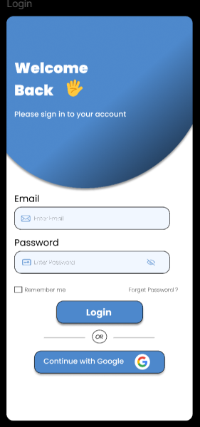
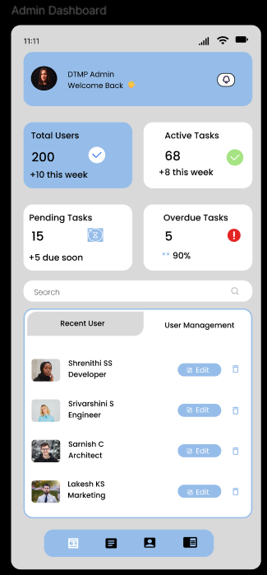
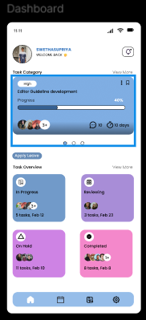
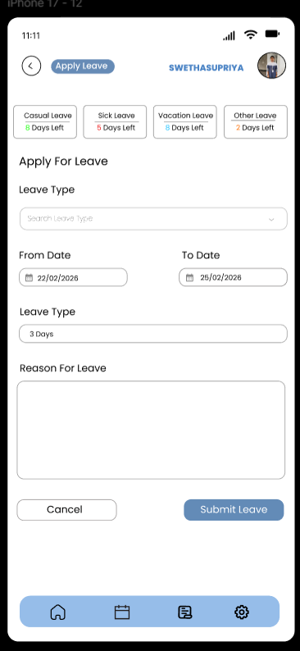

Slide 6
What is Usability Feedback?
How Feedback Was Collected
Shared Figma prototype with users
Observed user interaction
Asked simple questions:
Is it easy to navigate?
Is anything confusing?
What can be improved?
Feedback collected from users after interacting with design Helps understand:
Where users struggle
What confuses them
What can be improved

Slide 7
Key UX Issues Identified
Design Iteration Approach
Dashboard overload
Apply leave form complexity
Calendar too dense
Admin panel lacks hierarchy
Inconsistent UI design
Used structured method:
Before → Issue → After → Impact
Identify problem
Improve design
Measure usability improvement

Slide 8
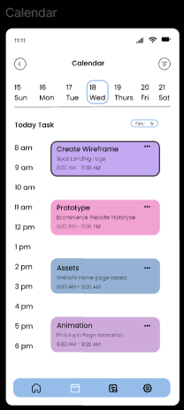
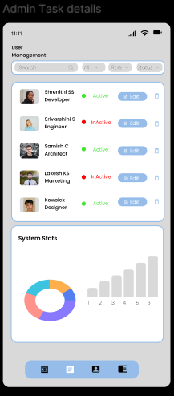
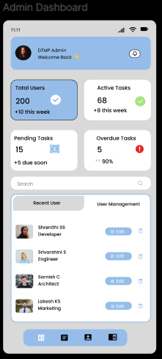
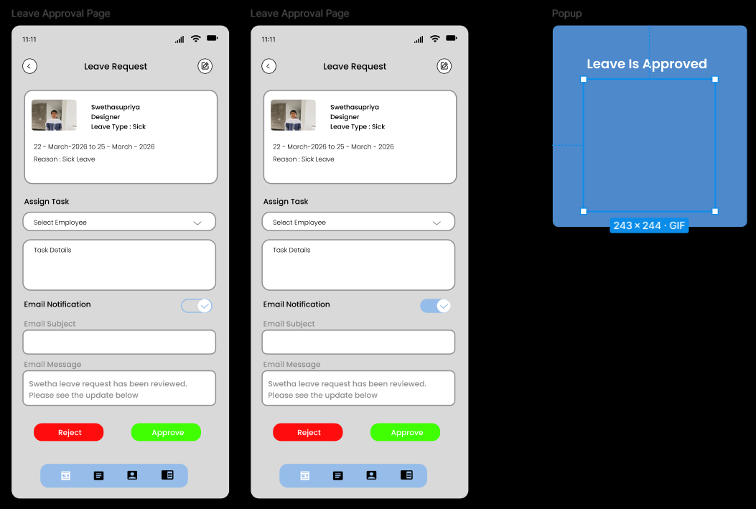

Slide 9
UI Improvements Implemented
Impact of Improvements
Better user experience
Faster task completion
Reduced confusion
Improved readability
More structured interface
Improved dashboard hierarchy
Step-based leave application
Reduced calendar clutter
Enhanced admin panel layout
Improved consistency

Slide 10
UX Case Study & Final Outcome
Conducted usability testing to identify key UX issues
Simplified user flows and removed design complexities
Improved layout using clear visual hierarchy
Ensured consistency in UI elements and spacing
Enhanced overall usability and user experience

Slide 11


